Slide 1
Algorithms, Flowcharts, and Problem Solving
By Saygin Guven
Introduction

Slide 2
Flowchart concept
Shape-meaning
START
INPUT
PROCESS
DECISION
END
OUTPUT

Slide 3
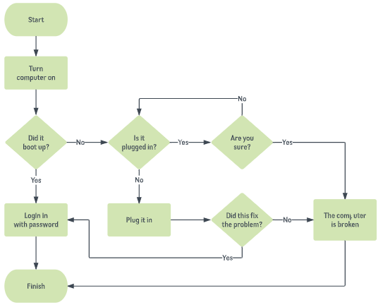
Flowchart

Slide 4
Flowchart
Number < 101 ?
START
Number = 1; Sum = 0;
Sum = sum+1; number ++
YES
NO
PRINT SUM
END

Slide 5
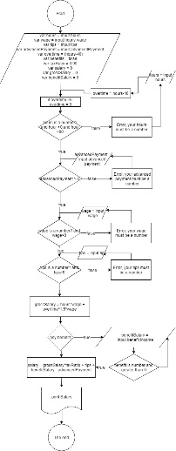
Print a salary slip
What do you need?
GIGO Concept handling inputs

Slide 6
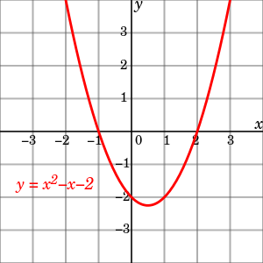
quadrilateral equation

Slide 7
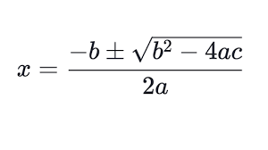
quadrilateral equation
y = x² − x − 2
− 2
+1
y = (x-2)(x+1)

Slide 8
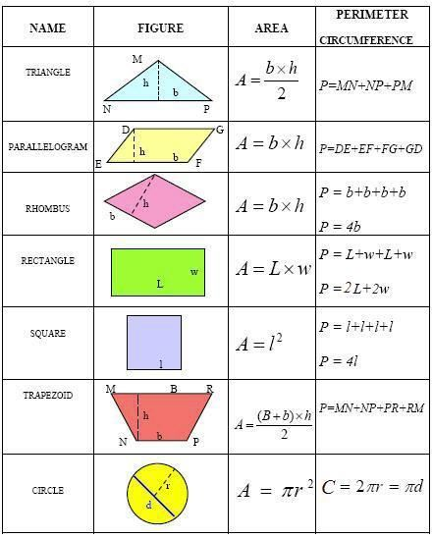
2D shape perimeter and Circumference

Slide 9

From the ITD Canada team!!!

